Slide 1
Proposed Canola Oil Transload Facility

Slide 2
DP World Fraser Surrey
Proposed Canola Oil Transload Facility
Agenda
Introductions
Overview of DP World
Overview of the proposed facility
Overview of construction
Feedback opportunities
Q&A

Slide 3
WE MAKE TRADE FLOW TO CHANGE WHAT’S POSSIBLE FOR EVERYONE
OUR PURPOSE
We’re on a mission to reimagine the global supply chain. And make the flow of trade smarter, faster and more sustainable.
By building better ways to bring goods to more people, we can all thrive in ways we never thought possible.

Slide 4
TO LEAD THE FUTURE OF WORLD TRADE
OUR VISION
By leveraging our portfolio of world-class infrastructure, strengthening global supply chains and generating sustainable economic growth.

Slide 5
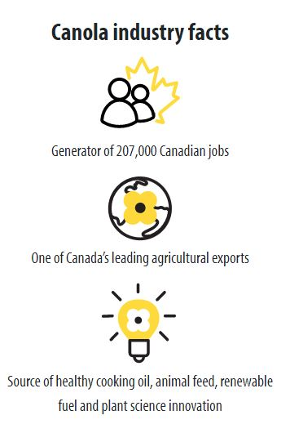
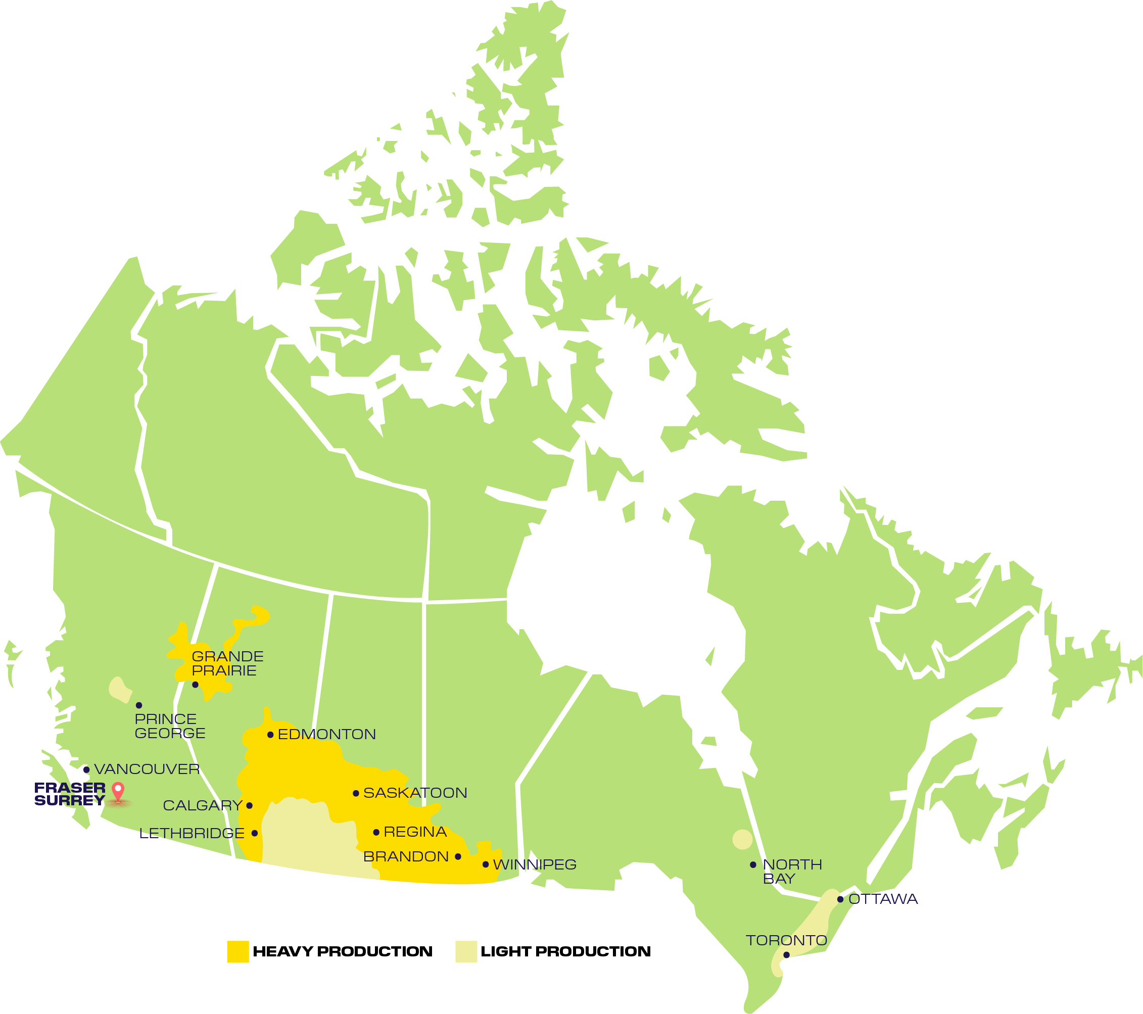
DP World Fraser Surrey
Proposed Canola Oil Transload Facility
To accommodate the rapid growth of canola oil production across the Canadian prairies, DP World is proposing to construct a new Canola Oil Transload Facility at our Fraser Surrey Terminal
From the Canola industry in Canada, from farm to global markets (canolacouncil.org)

Slide 6
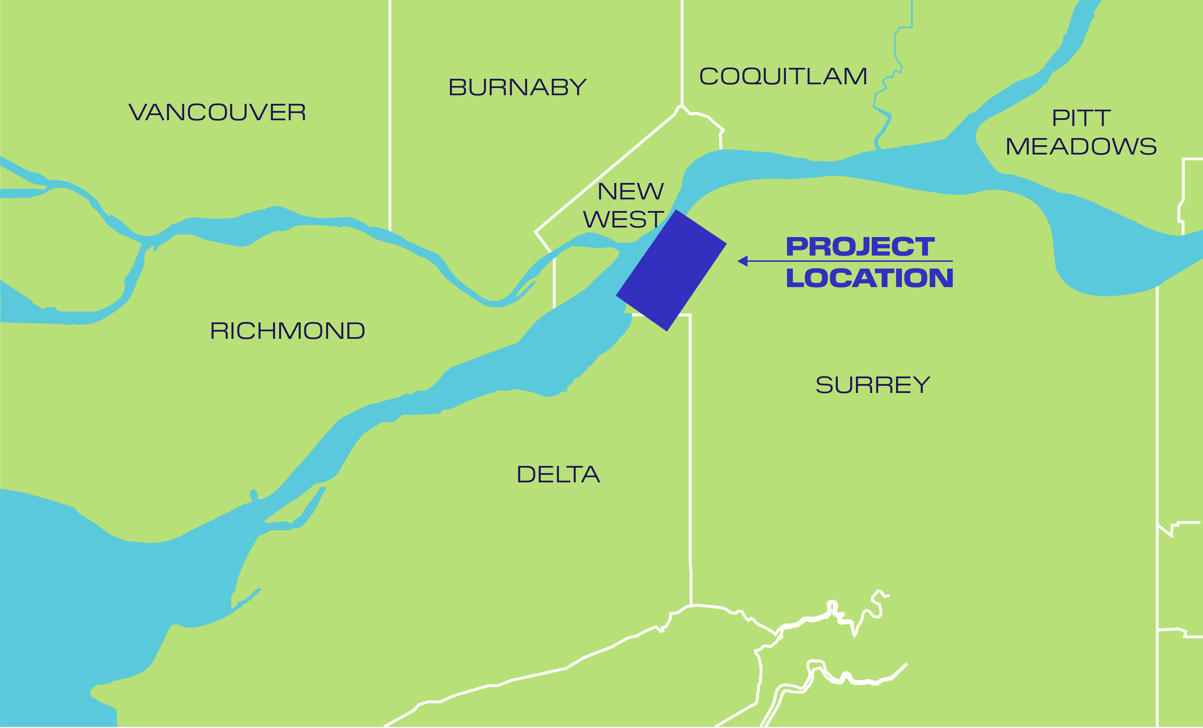
DP World Fraser Surrey
Proposed Canola Oil Transload Facility
We are proposing to redevelop a portion of our existing Fraser Surrey Terminal and Berth 10 located at 11060 Elevator Road, Surrey, BC to function as a canola oil transload facility.
Redevelopment would result in a canola oil throughput capacity of approximately 1,000,000 tonnes per year.

Slide 7
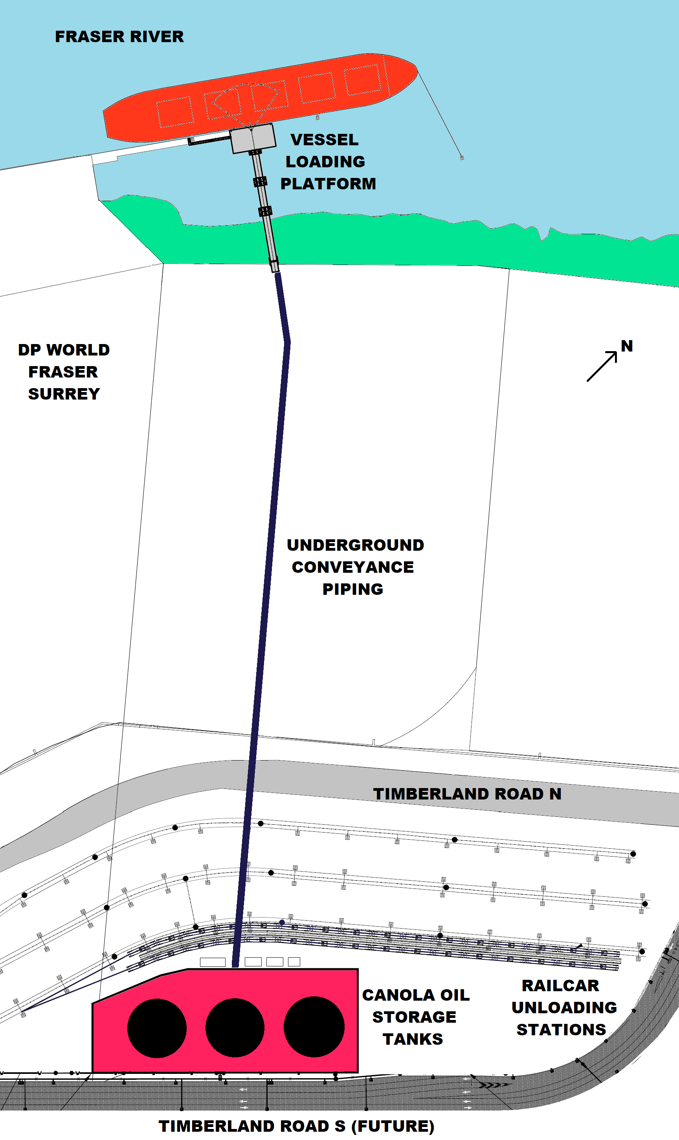
DP World Fraser Surrey
Proposed Canola Oil Transload Facility
The Project broadly consists of the following components:
Installation of two rail spur tracks (one replacement, one new) for rail unloading, including railcar offloading stations, pumps and piping
Three steel 15,000 metric tonne capacity storage tanks (18m high, 37m diameter) including containment walls
Installation of below grade canola oil transmission and recycle line to connect storage tanks to the marine trestle
Construction of marine access trestle and vessel loading platform including a marine loading arm and upgraded berthing safety
Development of ancillary facilities including control building, motor control centre, lighting, and site vehicle parking

Slide 8
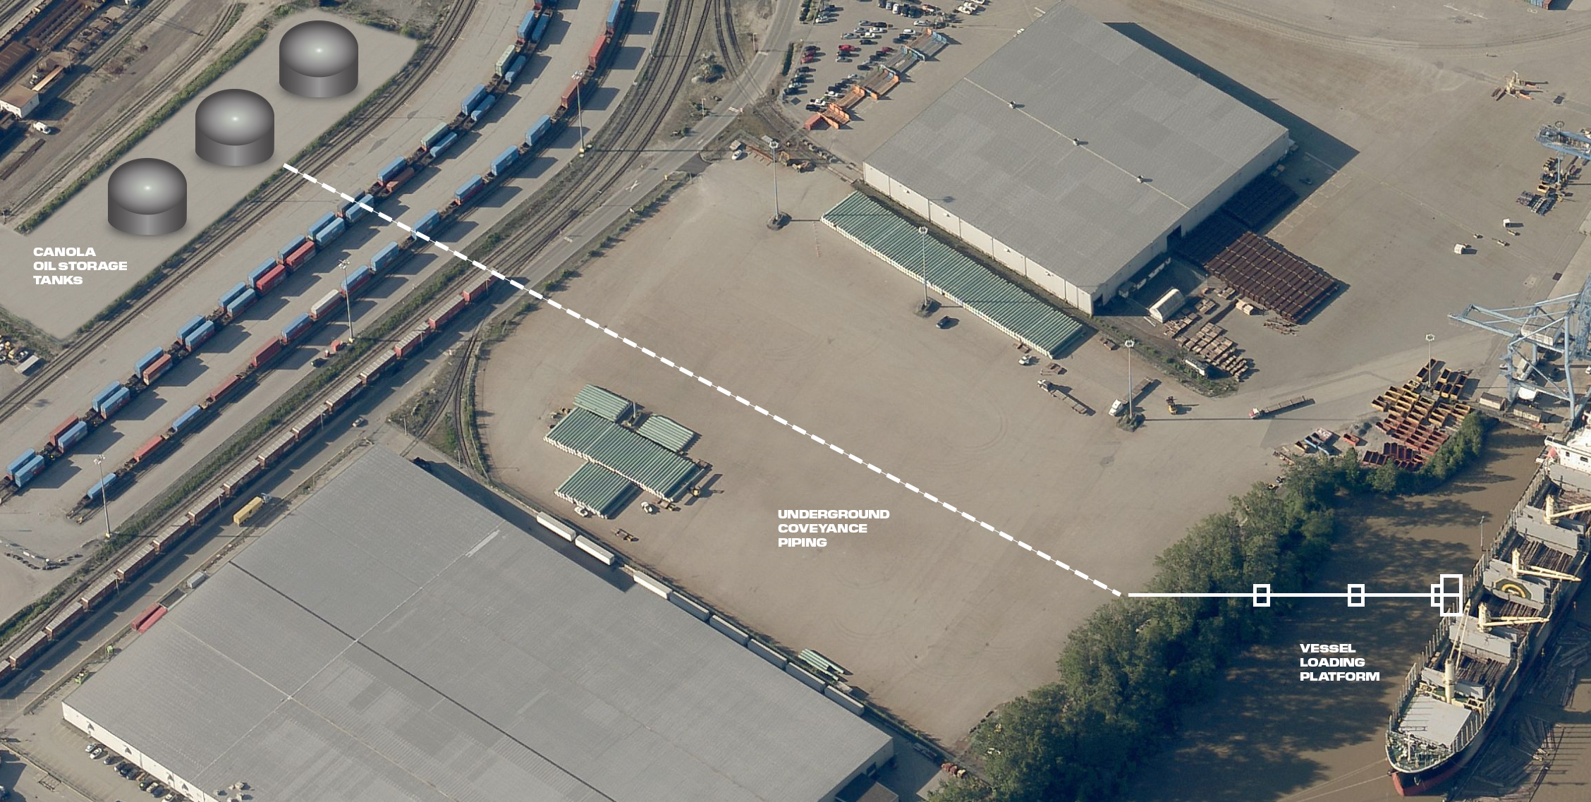
DP World Fraser Surrey
Proposed Canola Oil Transload Facility - Operations
Canola oil would arrive by railcars where it will be unloaded into storage tanks before being pumped into bulk carriers for export to global markets.

Slide 9
DP World Fraser Surrey
Proposed Canola Oil Transload Facility - Construction
If approved, construction is anticipated to start in the 2nd quarter of 2023 and should finish in the 4th quarter of 2024 .
As the project is located in an industrial area, there will be limited disruption to local residents.
Nearby businesses may experience increased noise, light, dust, air emissions and traffic as a result of the construction and mitigation measures for these impacts will be in place including dust control, no idling and traffic flagging.
The vast majority of construction will take place during Vancouver Fraser Port Authority construction hours Monday to Saturday between 7am and 8pm.

Slide 10
DP World Fraser Surrey
Proposed Canola Oil Transload Facility - Feedback
Feedback can be submitted through our feedback form on our website -https://www.dpworldcanada.com/projects/?a=fraser-surrey&b=canola-oil-transload-facility&c=phase-1
Feedback will be accepted until January 30, 2023
You can also submit feedback by email: DPWFS.Projects@dpworld.com
A summary report containing feedback will be posted on the Vancouver Fraser Port Authority website and will be considered by DP World through detailed design of the facility

Slide 11
Q&a

